Slide 1
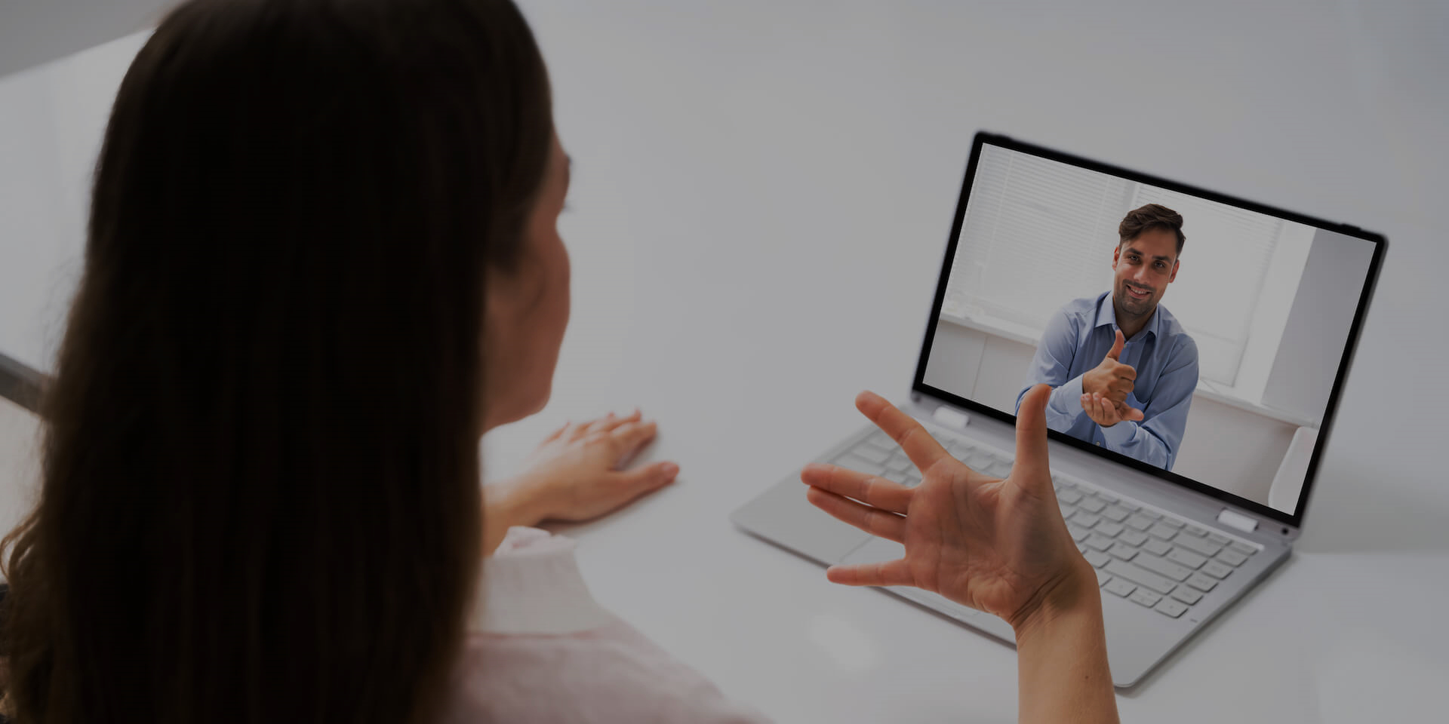
SignConnect: Sign Language Web Conferencing Tool

Slide 2

Outline
Background
Methodology
1
6
Problem Statement
Tools & Stacks
2
7
Objectives
Design
3
8
Significance
Timeline
4
9
Literature Review
Conclusion
5
10

Slide 3
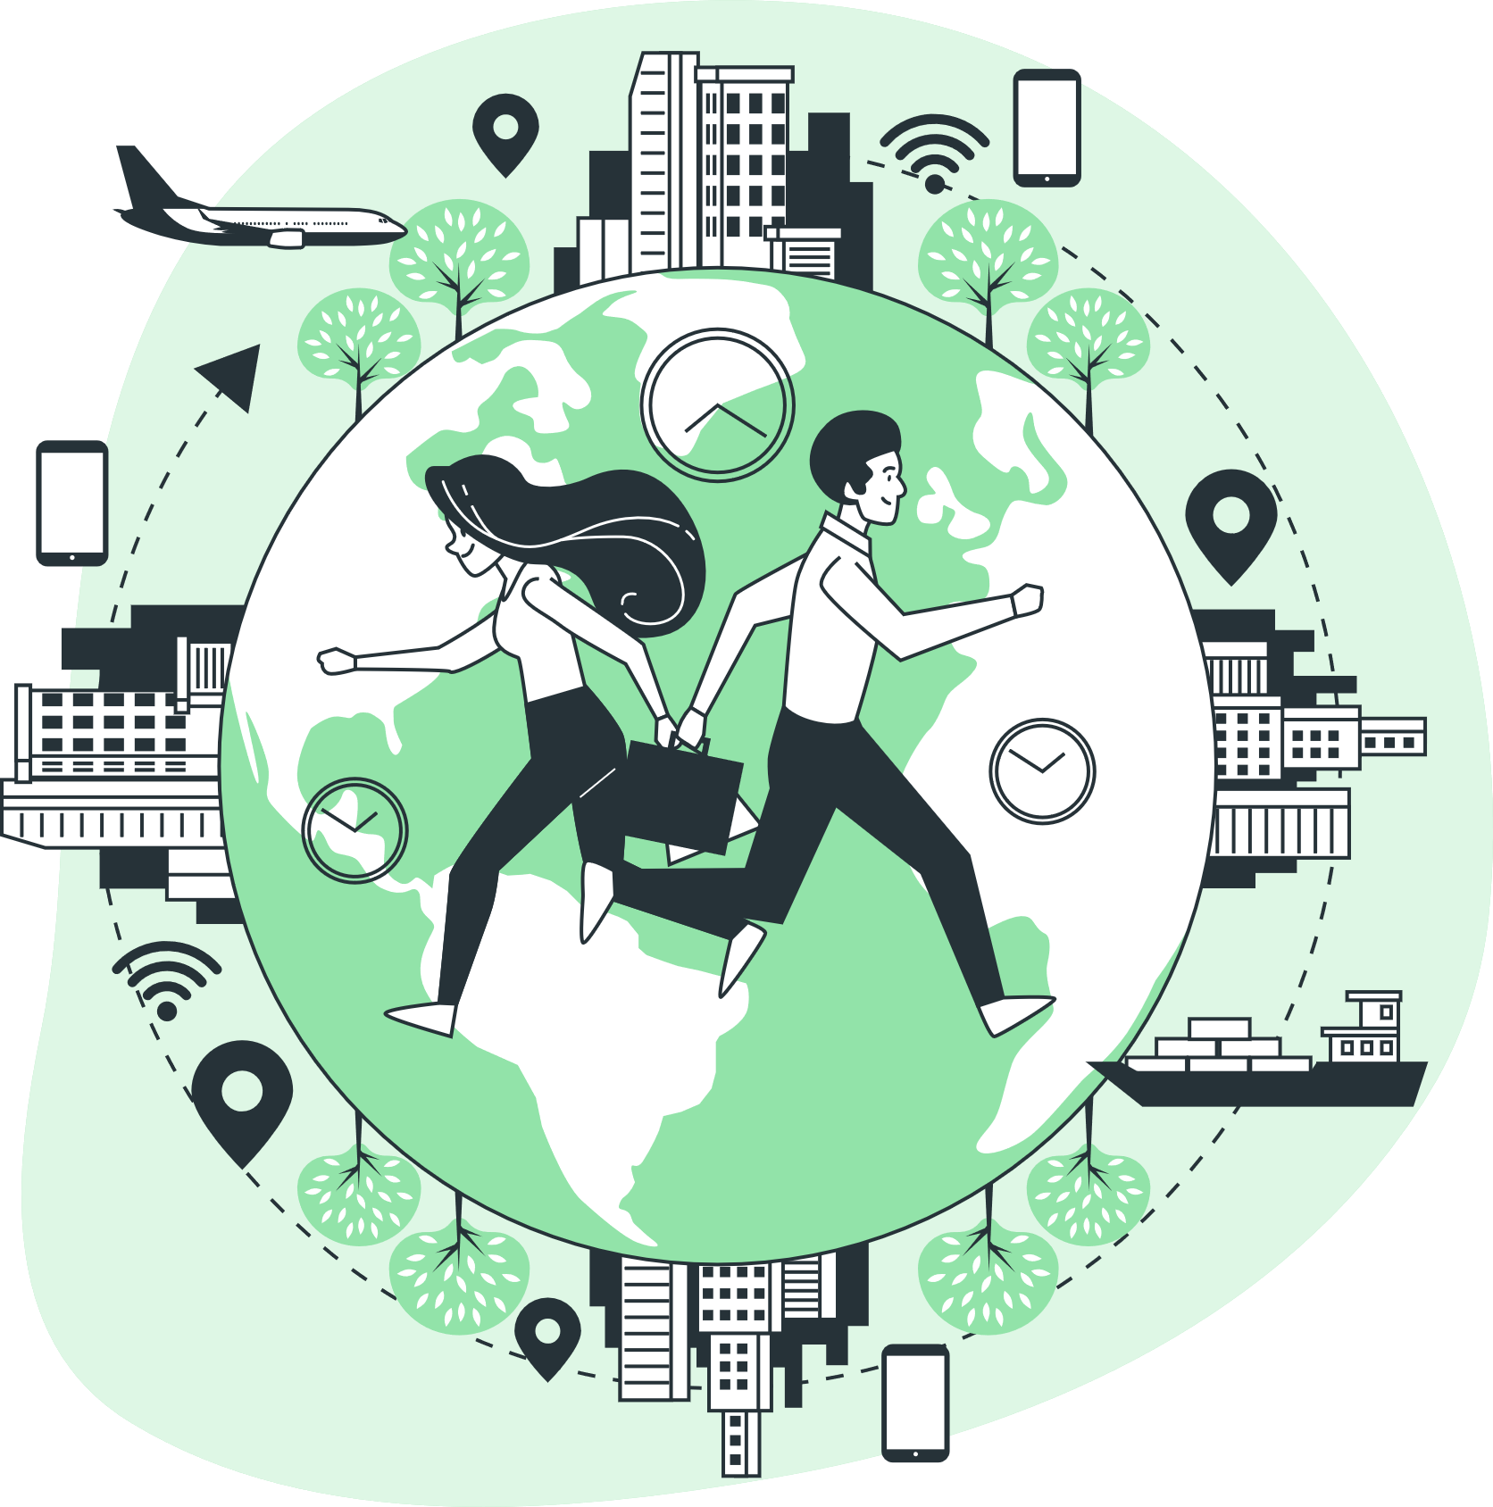
Background
Global Community

Slide 4




Calls
Text
Digital communication
Email

Slide 5
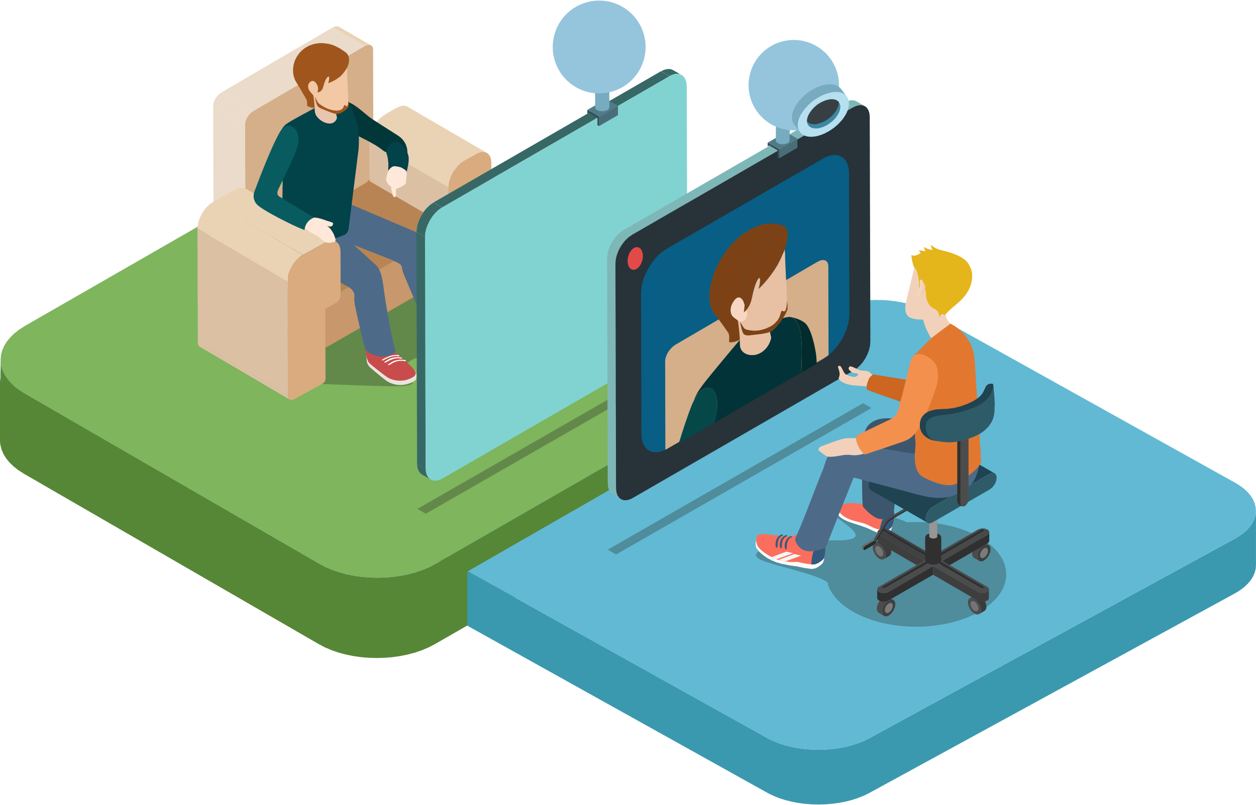

Video Conferences

Slide 6






Slide 7
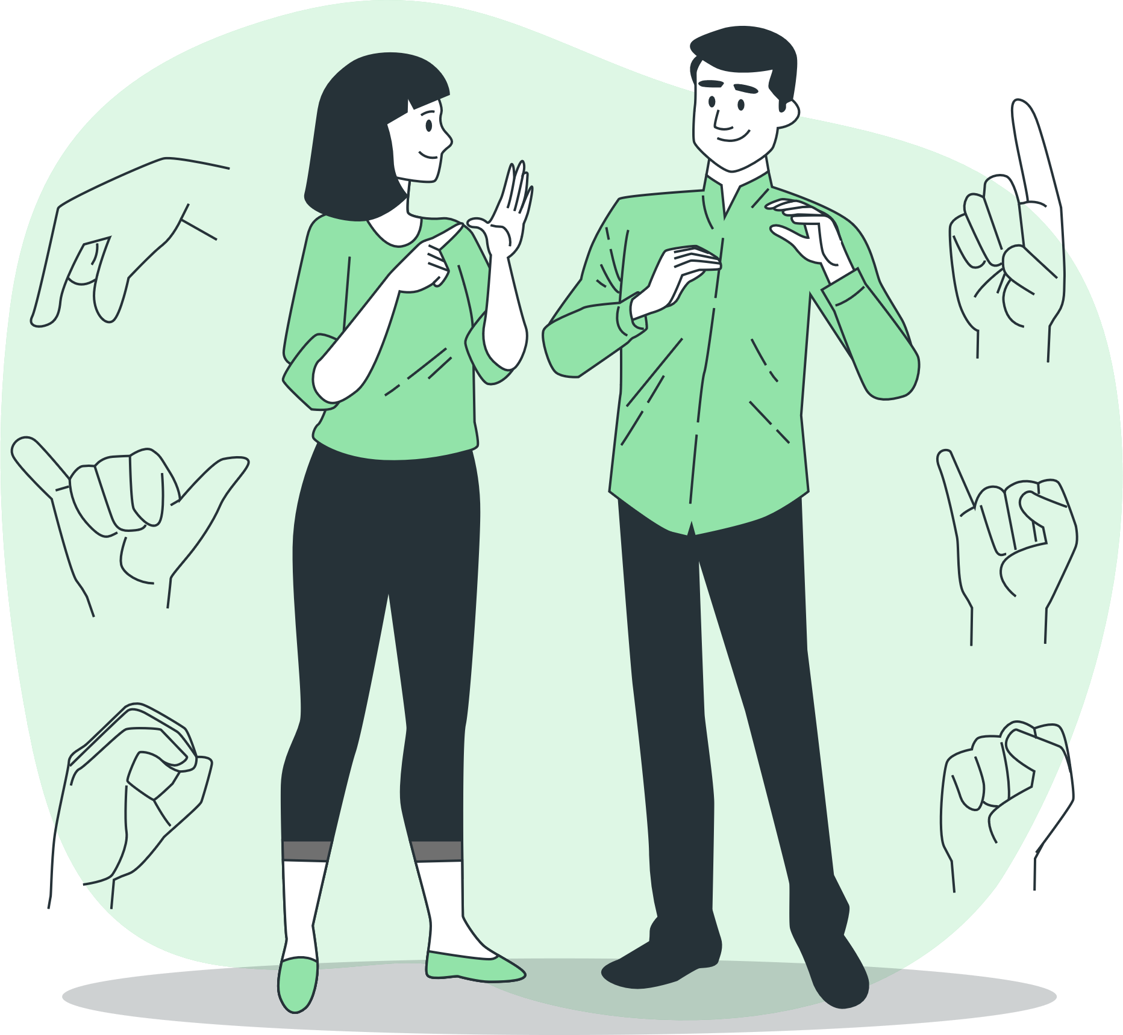
Deaf and Hard-of-Hearing
DHH Community

Slide 8

Problem Statement
There are no known video conferencing applications which is friendly to the DHH Community

Slide 9


Inspiration
Reduce Inequality
Good health &Well Being
SDGS 3 & 10

Slide 10
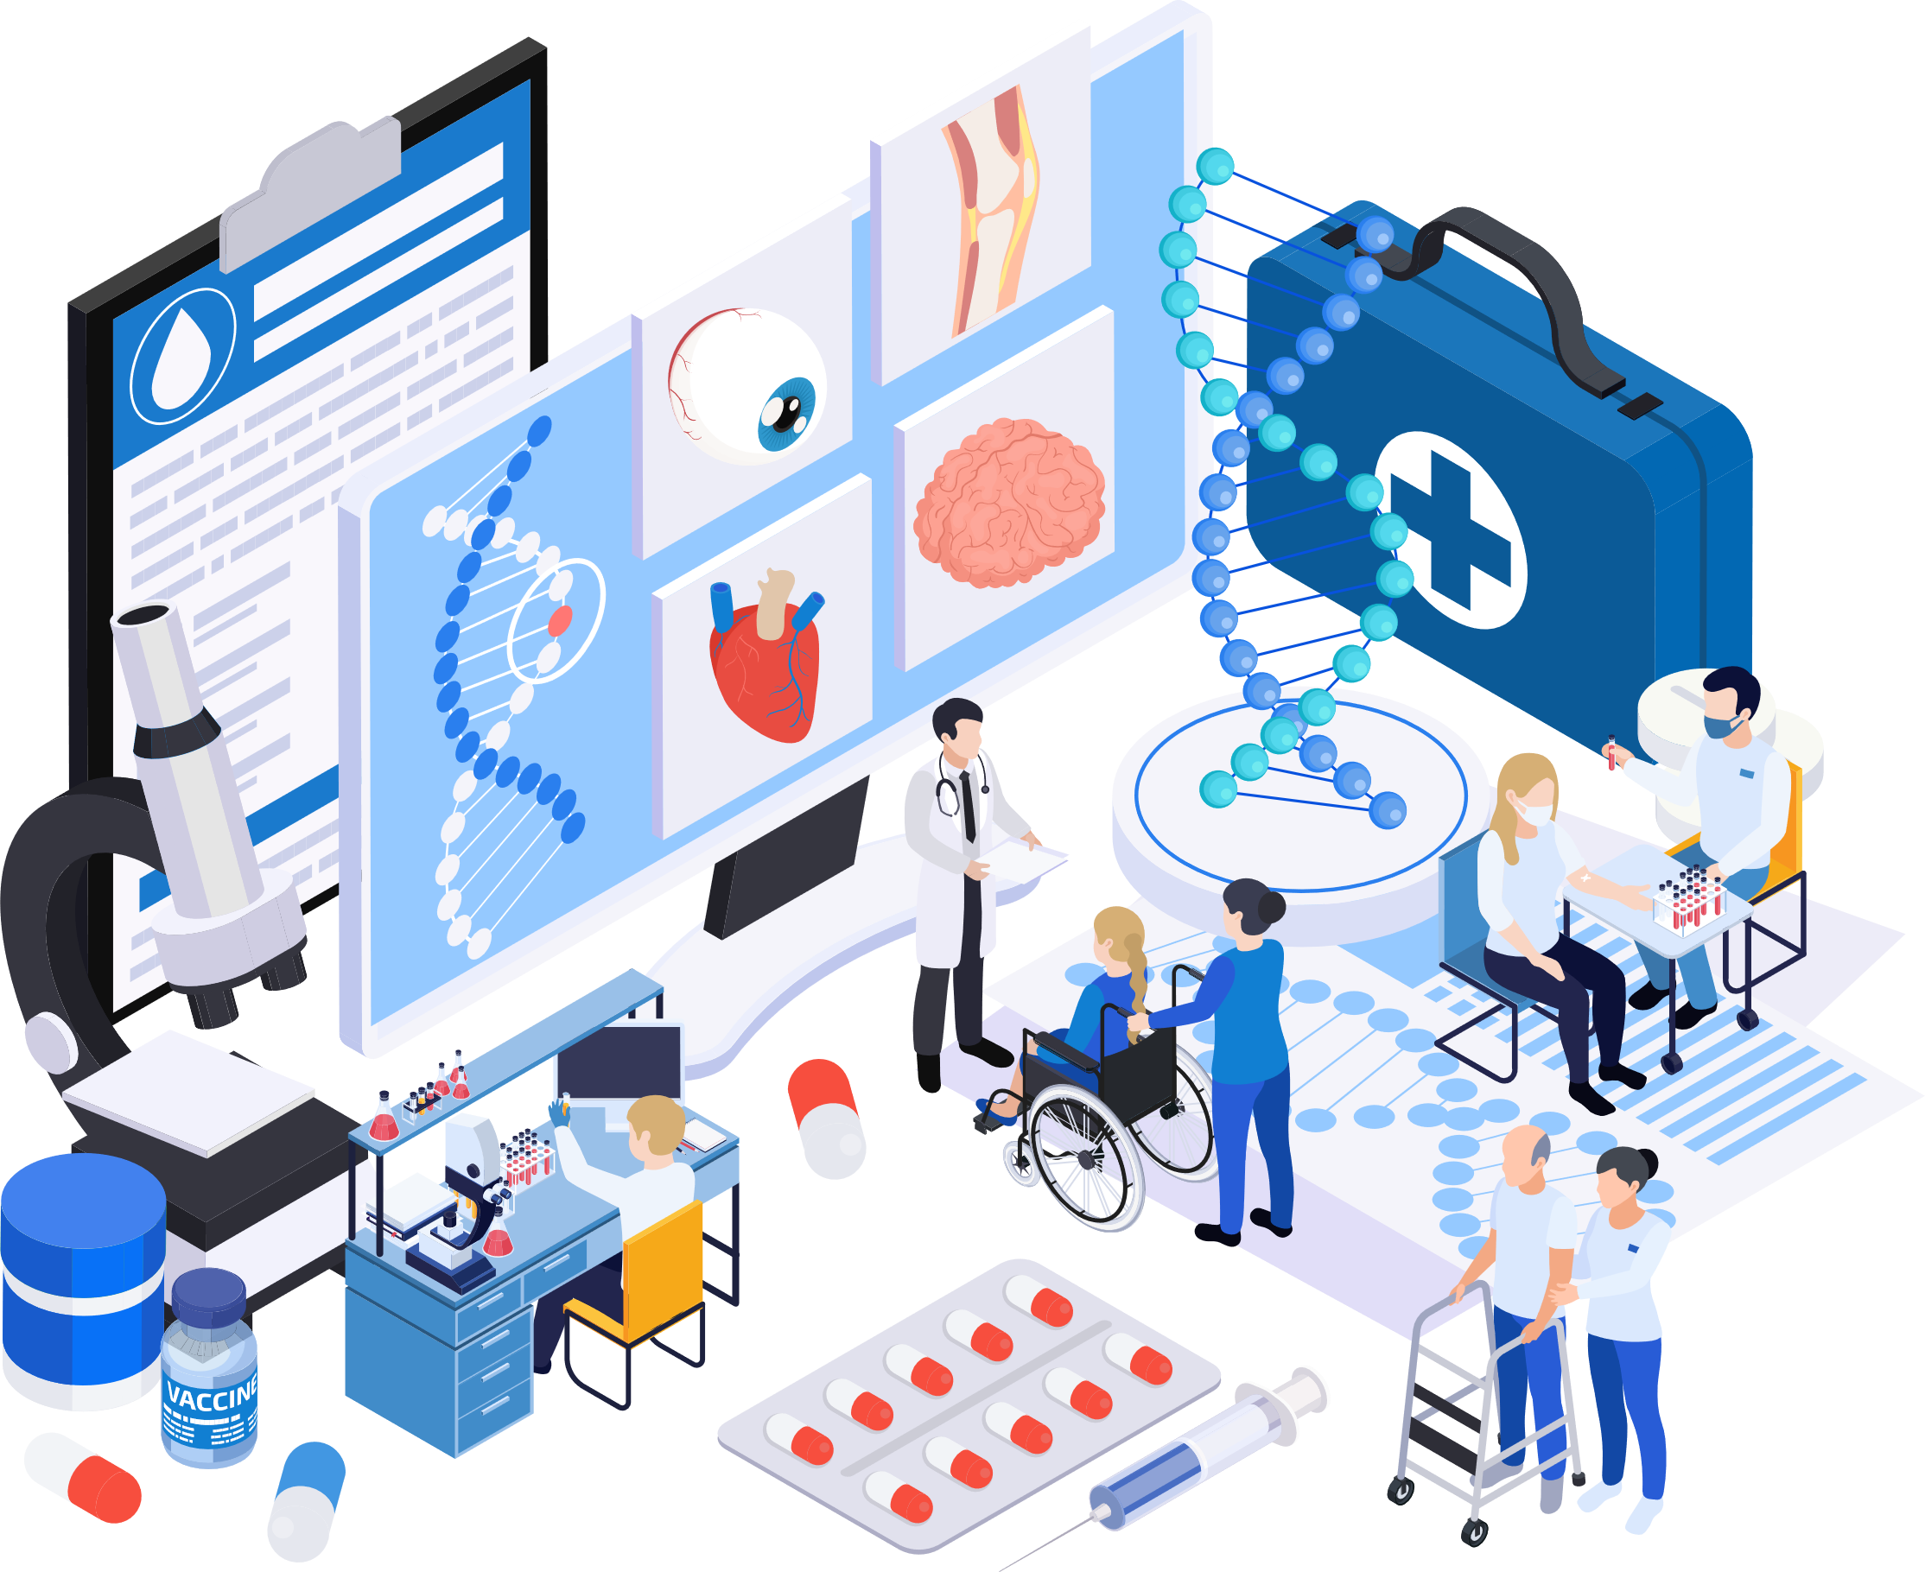
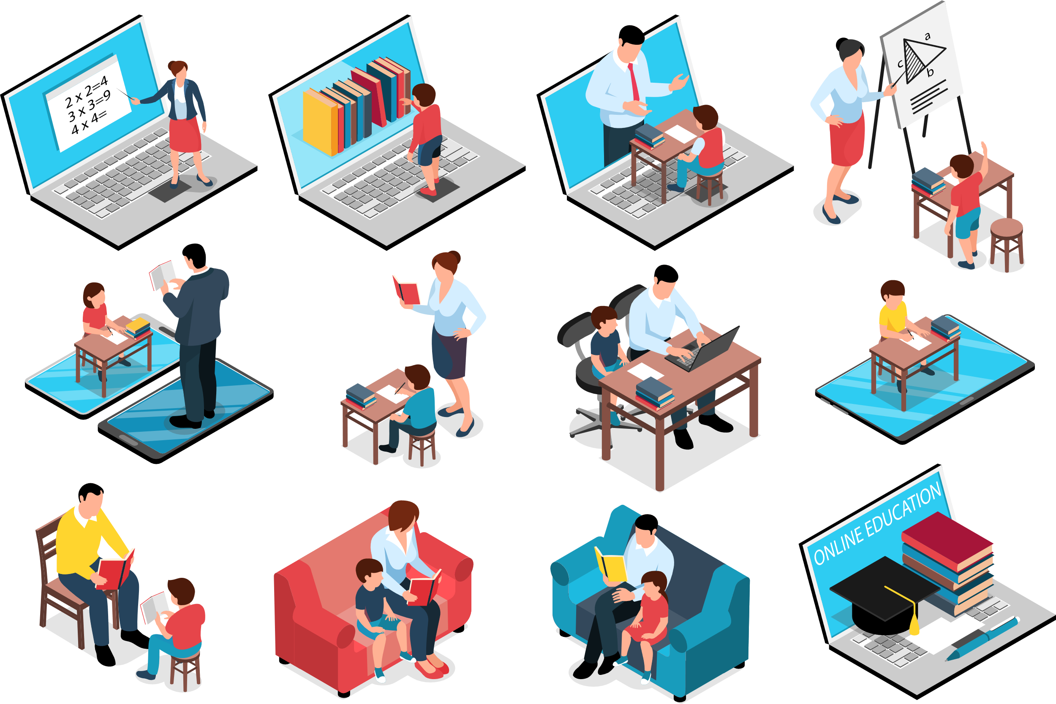
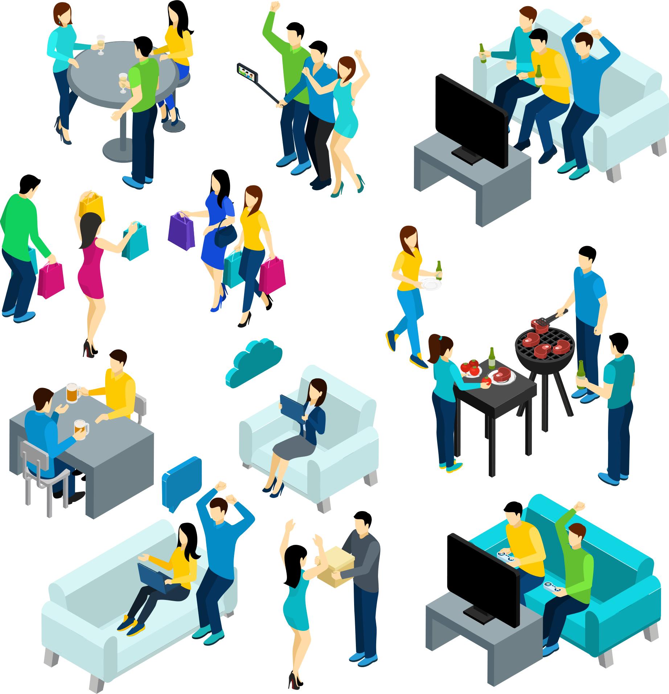
Health
Education
Social Interaction

Slide 11

Objectives

Slide 12
Objectives
General
Specific
Research and Development
User Engagement and Feedback
Scalability and Sustainability
Ethical Considerations
Real-time Sign Language Translation
Customizable Avatar Options
Seamless Integration with Video Platforms
User-Friendly and Accessible Design
Support for Multiple Languages and Sign Languages

Slide 13
Significance
To revolutionize communication by deaf individuals with others, making it easier and more effective.
To enable deaf individuals to participate more fully in various aspects of life, such as education, employment, and social interactions.

Slide 14
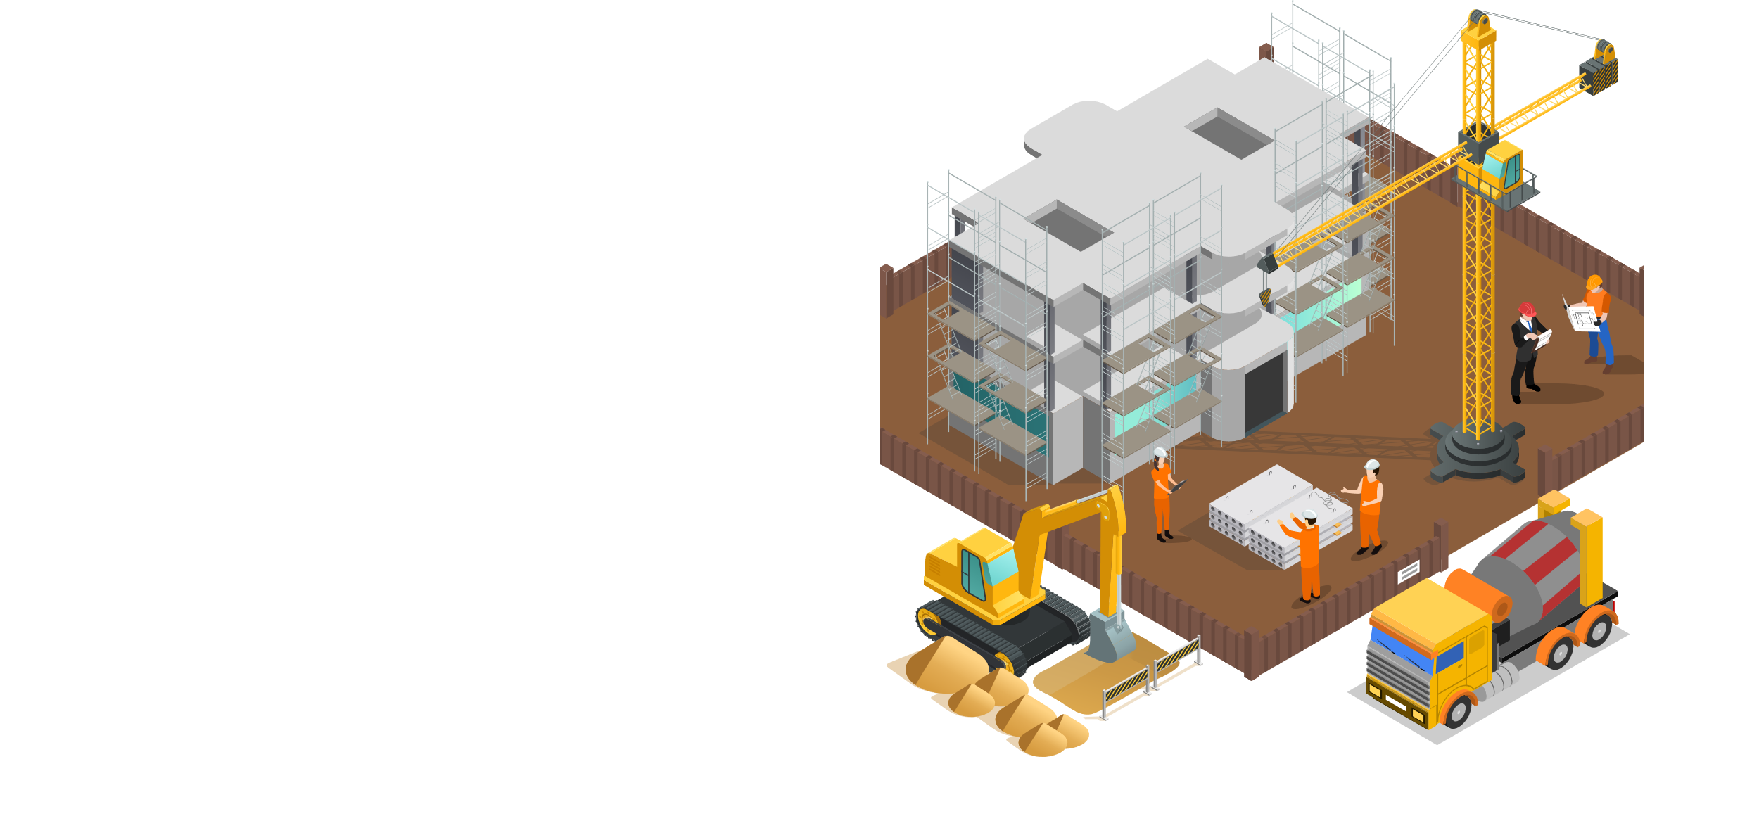
Related Works Overview

Slide 15
Metrics/Projects | American Sign Language Recognition Using Deep Learning and Computer Vision. | Indian Sign Language Gesture Recognition Using Image Processing and Deep Learning. | Deep Learning-Based Approach for Sign Language Gesture Recognition with Efficient Hand Gesture Representation | Bengali Sign Language detection
Models | Convolutional Neural Networks (CNN) with the Inception Recurrent Neural Network (RNN) model known as Long Short-Term Memory (LSTM) | multi-layered CNN architecture for static gestures and LSTMs with convolutional kernels for dynamic gestures. | Histogram of Oriented Gradients (HOG) and Convolutional Neural Networks (CNN). | K-Nearest Neighbour Haar-like feature based classifier
Accuracy(%) | 99 | 99.08 - Indian Sign Language 97.71 - American Sign Language - | 94.3 | 98.17
Advantages | Worked for both static and dynamic sign languages | Worked for both static and dynamic results | Accuracy for alphabet | Fast
Limitations | Limited ASL | Bound by accuracy |  | Recognized only vowels and consonance

Slide 16

Methodology

Slide 17
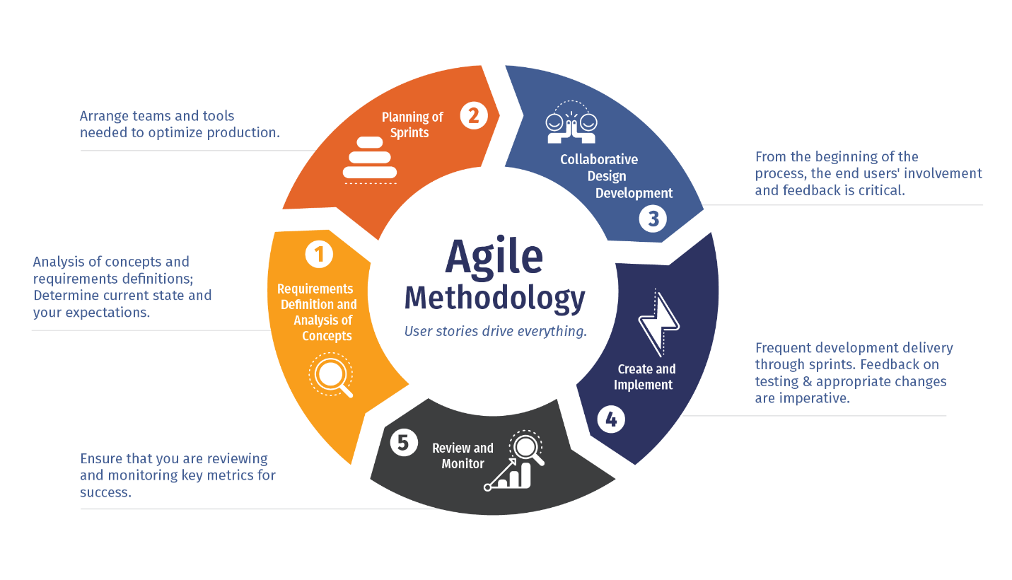

Slide 18
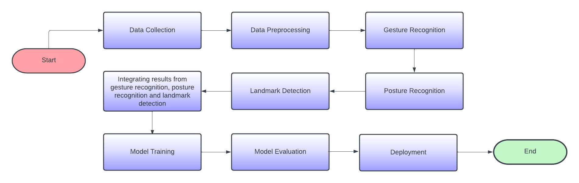
Block Diagram

Slide 19
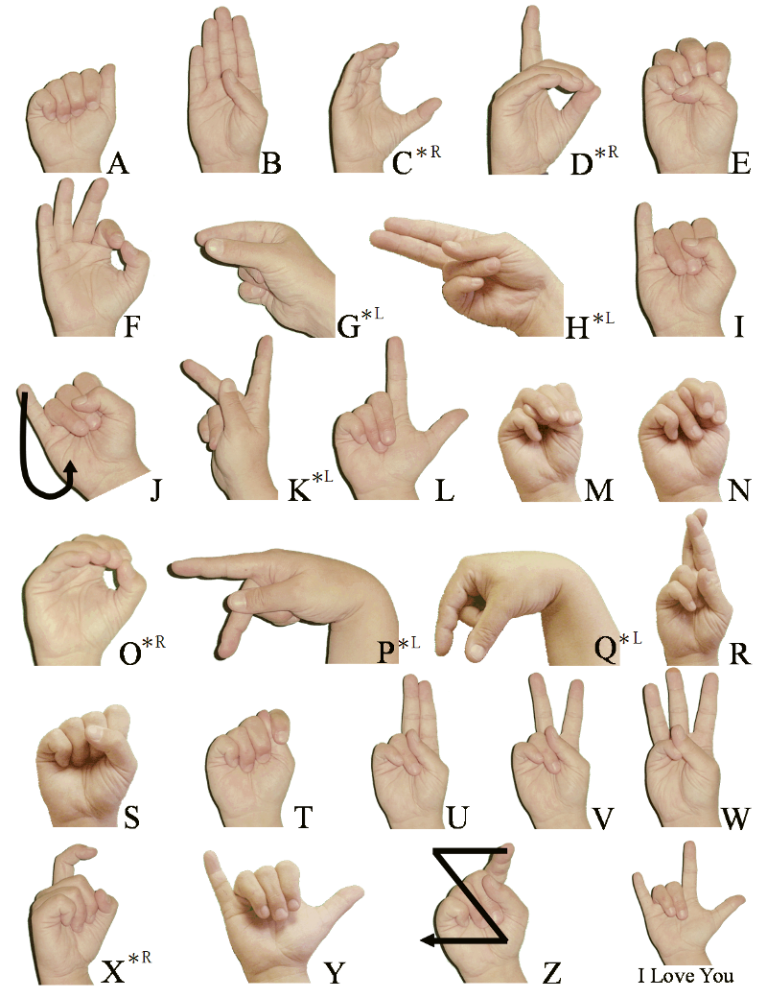
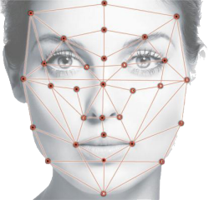
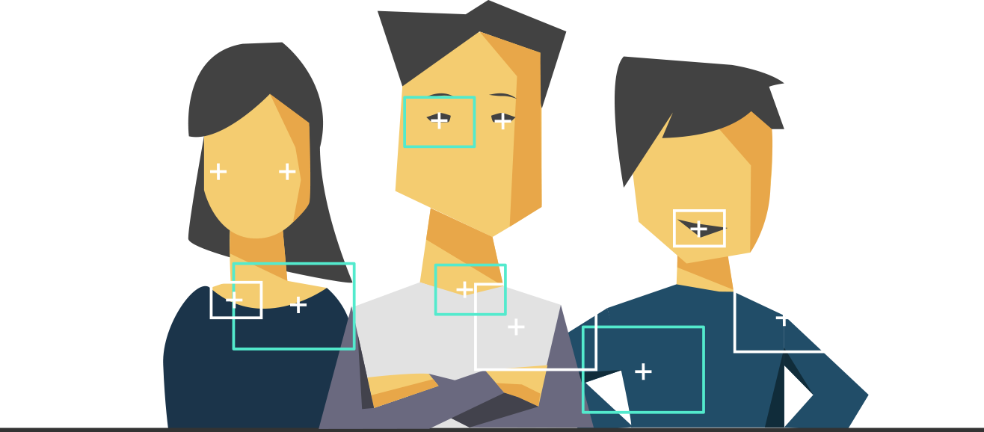

Models
Posture Recognition
Landmark Detection
Gesture Recognition
3D CNN + Transformer based models
MediaPipe
MediaPipe
Contains hand model called Mediapipe hands that can be used to extrand hand landmarks
3D CNN for capturing the temporal information of the gesture and will be fed into a Transformer model
Contains a model called MediaPipe Pose which can be used for posture recognition

Slide 20
UI/UX

Slide 21

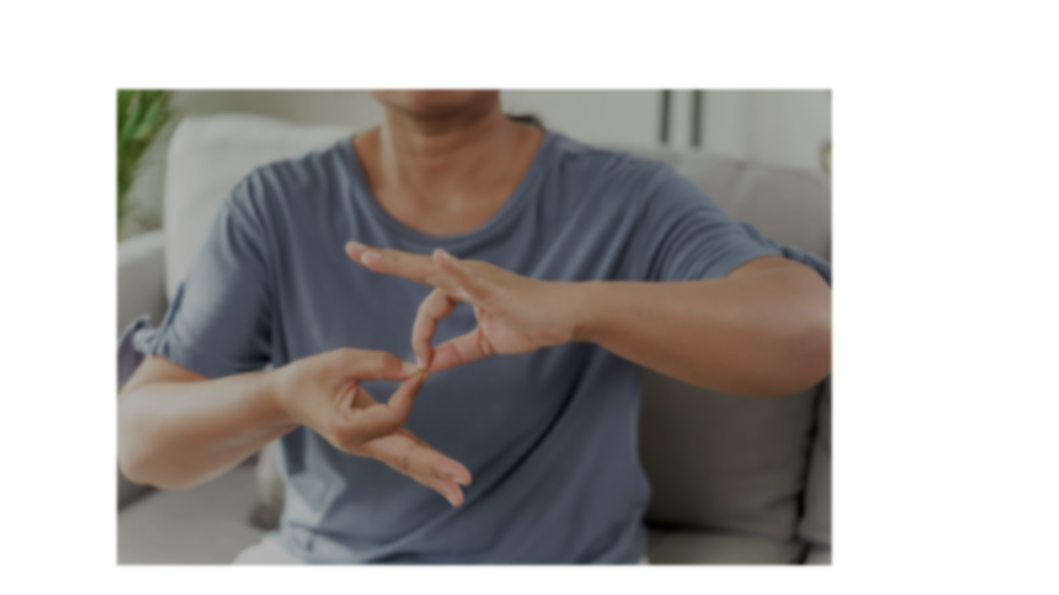




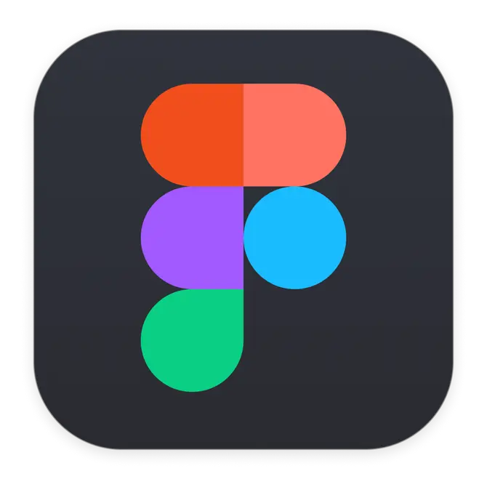

Python
React
MongoDB
Figma
GitHub

Slide 22
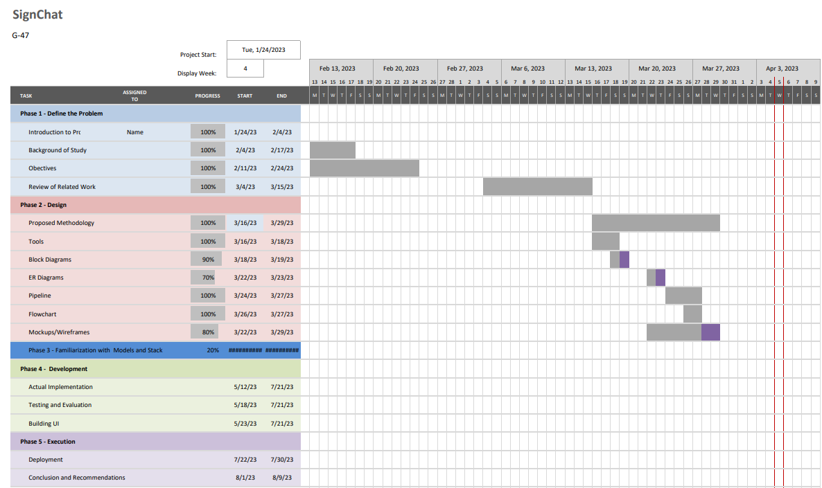

Slide 23
Conclusion

